Slide 1
Bomgar Remote support software

Slide 2
Introduction
Bomgar is a remote support software that includes chat, screen sharing, file transfer, and other troubleshooting tools.
It is useful for issues that require more hands-on troubleshooting and cannot be efficiently resolved via phone or email.

Slide 3
Downloading Bomgar onto your machine
Each group may have its own web portal
For the Help Desk it is ithelp.lsu.edu
Go to ithelp.lsu.edu/login
Enter your MyLSU credentials
If you do not have access to the site, contact your Bomgar administrator
You will see a button to “Download Bomgar Representative Console”
Click to download, then run the file to install the program

Slide 4
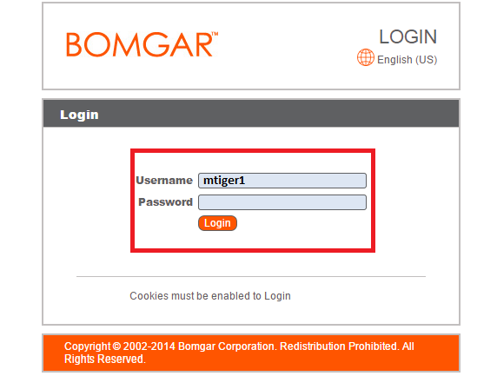

Slide 5
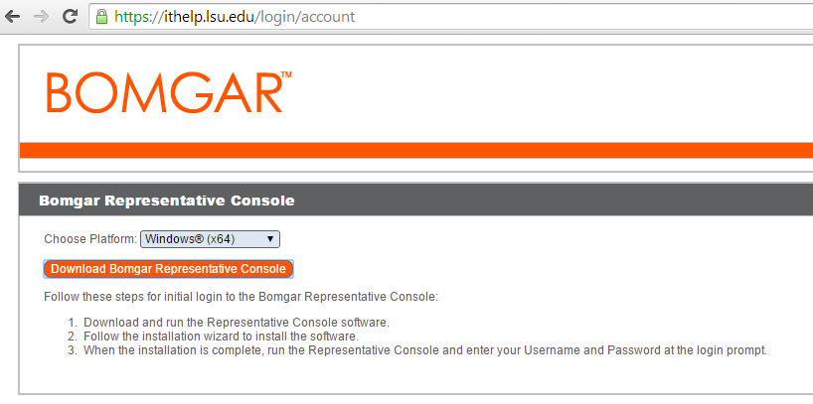

Slide 6
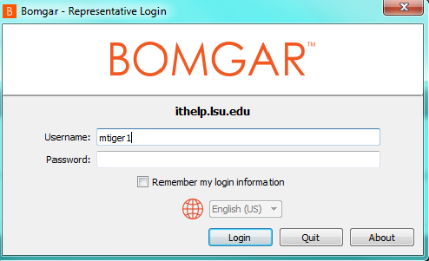
Using the Bomgar Software
Log into the software using your MyLSU username and password

Slide 7
Bomgar Home screen
From the home screen you can
  Manage your support sessions
  Generate a session key or session link for customers
  Change whether or not you are available to accept chat sessions
  Set up a presentation

Slide 8
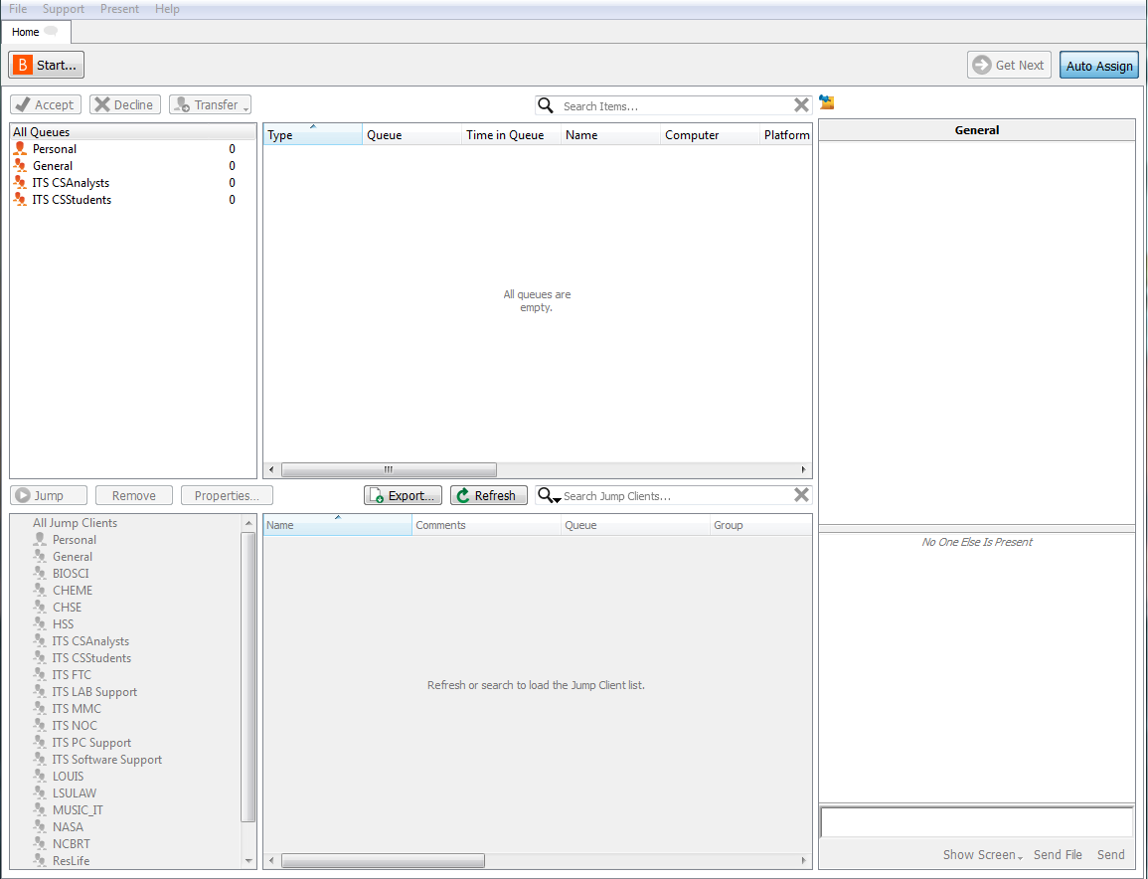

Slide 9
Get customer set up for session
There are several ways to invite a customer to start a support session
  Click the “Start” button at the top left of the screen
    Choose “Generate session key” and have the customer enter the number at the Bomgar web portal
    Choose “Email a link to a customer” which will open a new message in your email client with a link to the session
  Click the “Support” menu at the top left of the page then “Generate Session Key”
    Provide the customer with the generated number
    Copy and paste the link into an email or other type of message
    Here you can adjust the length of time for which the key and/or link is active

Slide 10
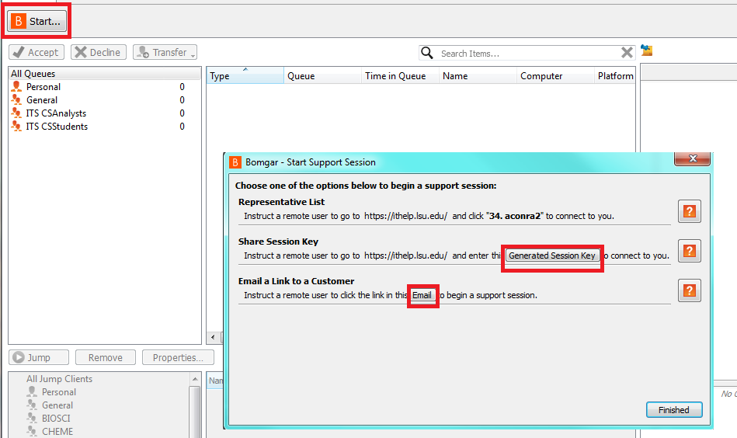

Slide 11
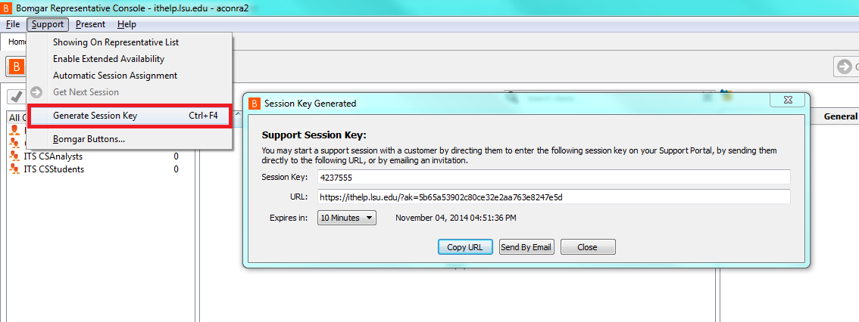
Notes:
Now there is a public portal option

Slide 12
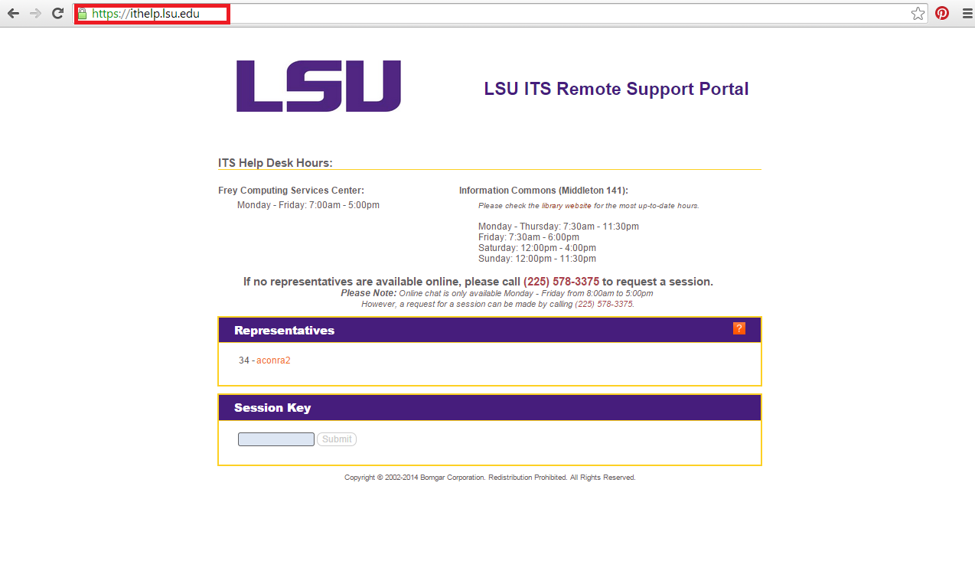
Bomgar Web Portal
Notes:
If you choose to have your name visible on the web portal, you can have the customer click on your name to start a chat session with you. From here you can send them a request to launch the full Bomgar client if necessary and from there you can begin screen sharing. You can change the name that displays here and in the program by logging into ithelp.lsu.edu/login and scrolling all the way down to the bottom of the page and changing your name and display name.

Slide 13
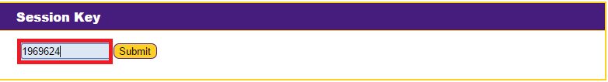
To have the customer begin a support session with a session key
  Have them navigate to ithelp.lsu.edu (or your group’s specific web portal)
  They should enter the number with which you provide them into the “session key” box
  They should then press “submit”

Slide 14
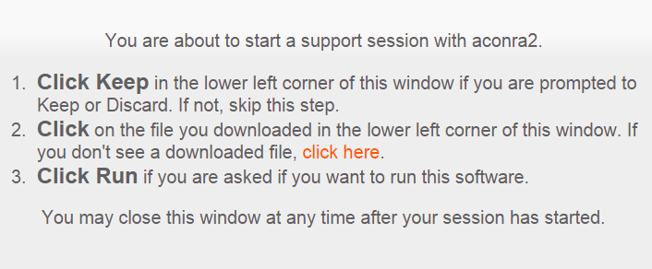
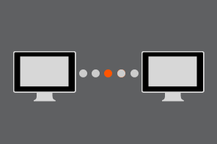
  The connection should start automatically
  However, a file may be downloaded for them to click and run
  In either circumstance, instructions will appear on their screen
  Once the connection has begun or they have run the file, an image of two computer monitors will appear until the connection is established

Slide 15
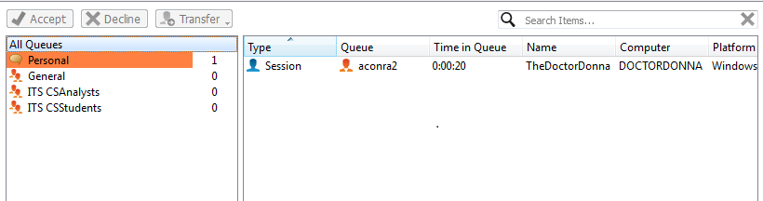
Beginning a session
Once the connection has been established, a session will appear in your queue
You can accept by single clicking and pressing “Accept”, by right clicking and accepting, or by double clicking
You can also transfer the session to another available representative if you are no longer able to assist the customer
You can only decline a session that comes to you when the customer clicks your name at the web portal to chat, not when using a session key or email link

Slide 16
After accepting the session
You will initially be set up in a chat session with the customer with options to start other types of troubleshooting
From here you can determine what type of support will be best for the customer
You can chat, send files, access the command prompt, and view system info such as browser version and recent events, all without initiating screen sharing
You can also transfer the session from here or add in other representatives for additional support

Slide 17
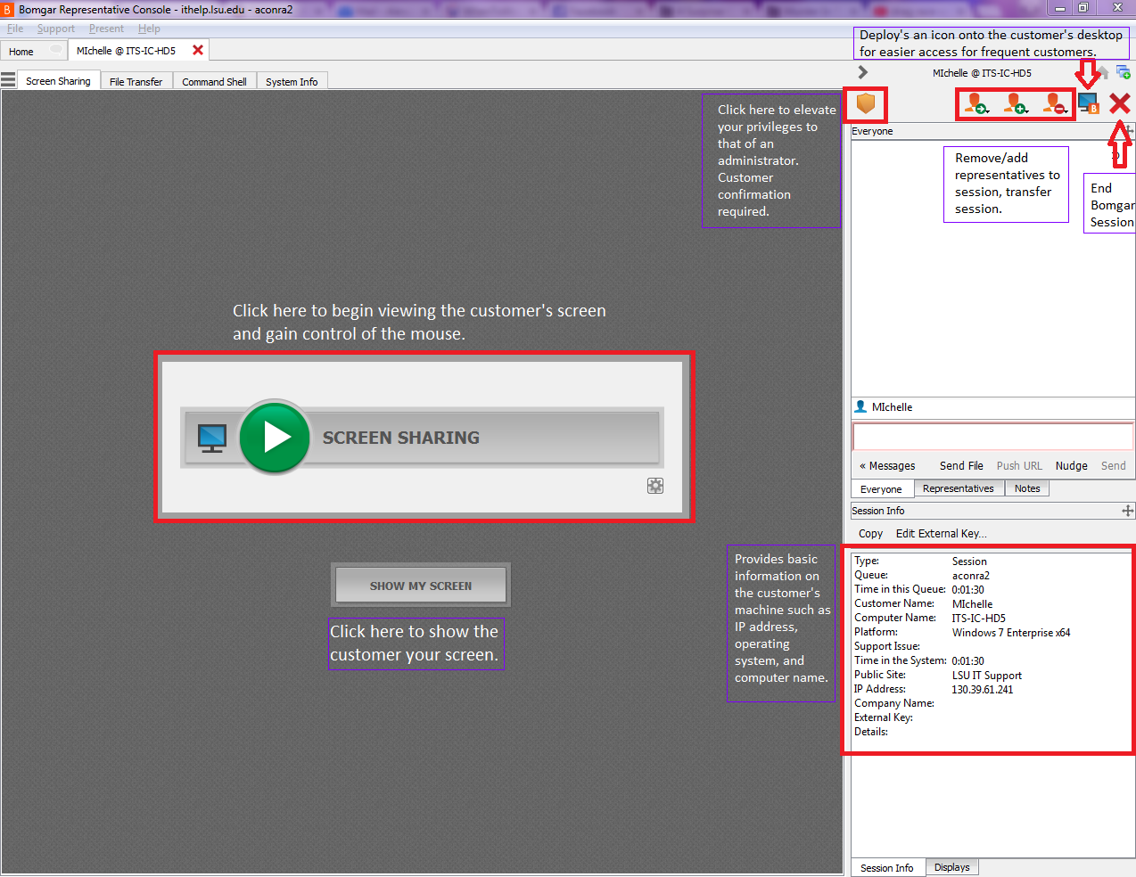
Notes:
Fix typos/font color

Slide 18
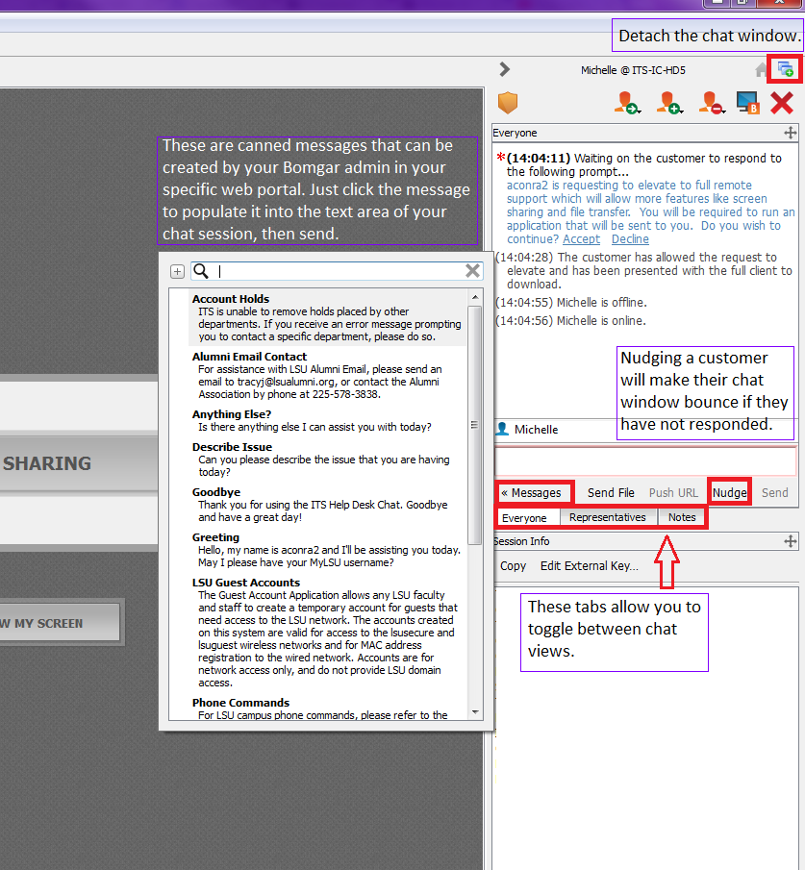
Notes:
Fix typos in note text and change font color

Slide 19
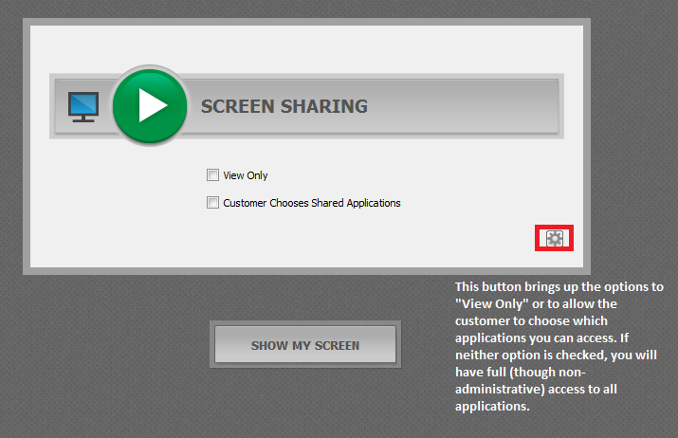

Slide 20
Screen sharing
Once you begin screen sharing, you can use the customer’s computer just as you would any other computer
There are also tools built into Bomgar to facilitate troubleshooting
These include drawing tools, control panel tools, reboot tools, buttons to take screen shots, etc.

Slide 21
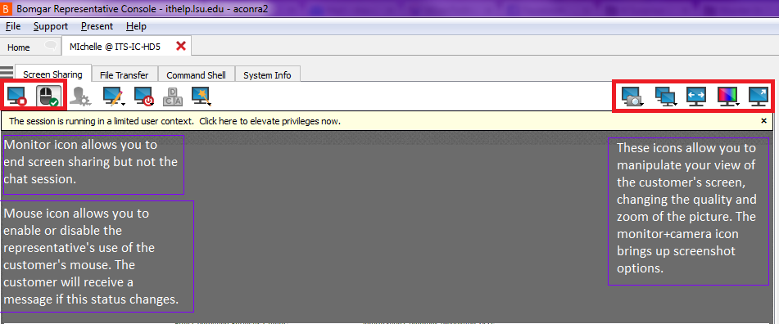
Notes:
Fix typos

Slide 22
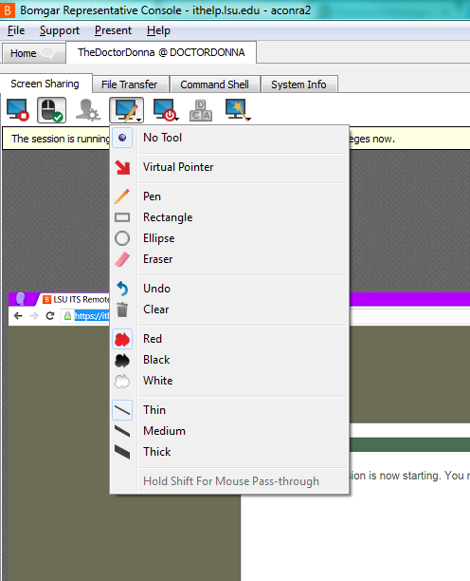
There are also drawing tools that can be used to guide customers to take certain steps or highlight certain features of a program

Slide 23
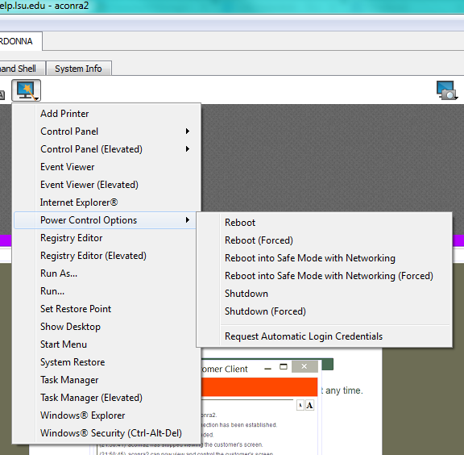
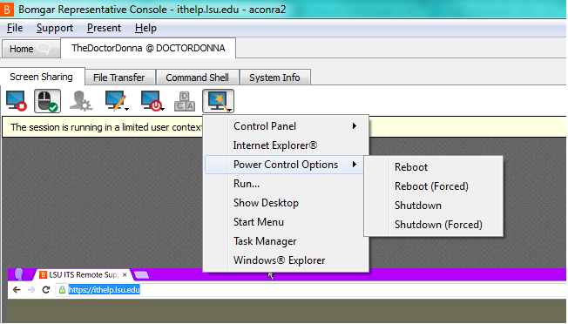
Some tool menus offer more options when your privileges have been elevated to administrator
Initial Privileges
Elevated Privileges
Notes:
These tools will be slightly different when screen sharing with a Mac machine.
All of these options can also be accessed through the customer’s OS, this menu is just there as a short cut.

Slide 24
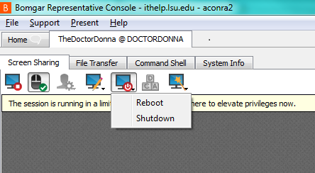
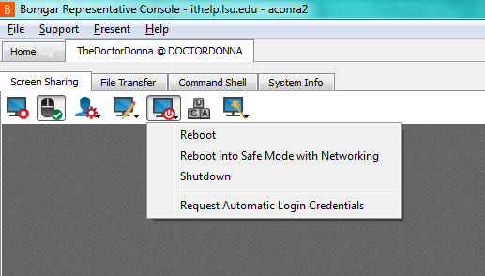
Initial Privileges
Elevated Privileges
Notes:
**Note
If you choose to reboot the machine during a session, the session should reconnect once the computer has fully restarted. The connection attempt will timeout, however, if the reboot takes more than a few minutes. This often happens when the computer is installing updates.

Slide 25
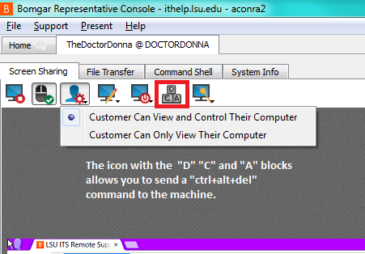

Slide 26
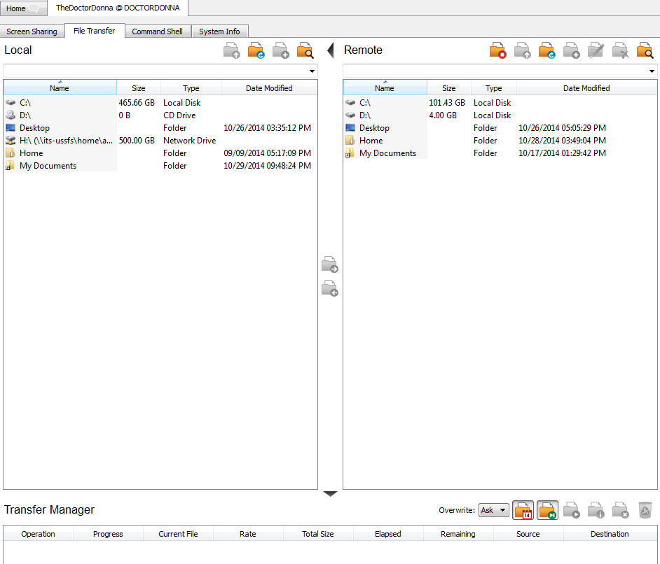
Non-screen sharing options
There are several tabs in addition to the Screen Sharing tab that assist in troubleshooting

Slide 27
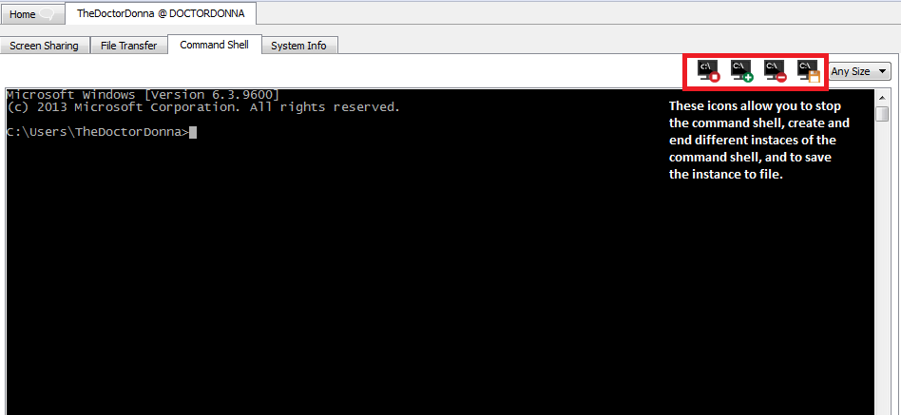
Notes:
The command shell functions just as it would on a PC or as terminal does on a MAC.

Slide 28
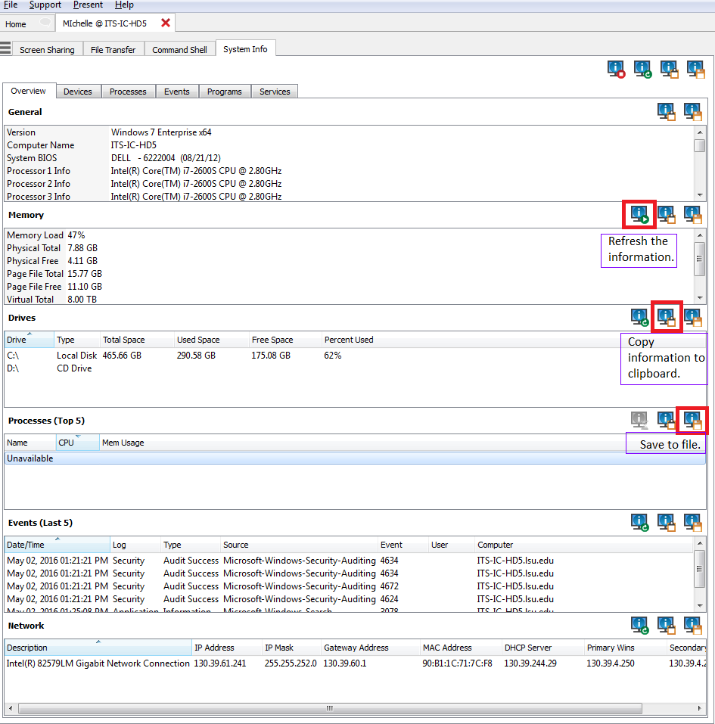
The “System Info” tab allows you to view information ranging from the customer’s default browser and its version to what processes are running to what events have recently occurred on the machine including error messages
Notes:
Change note font color

Slide 29
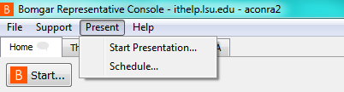
Presentations
There is also an option to host a presentation of your screen to multiple participants
Once you start a presentation, you can choose which of your windows can be viewed by the participants and preview what they would see

Slide 30
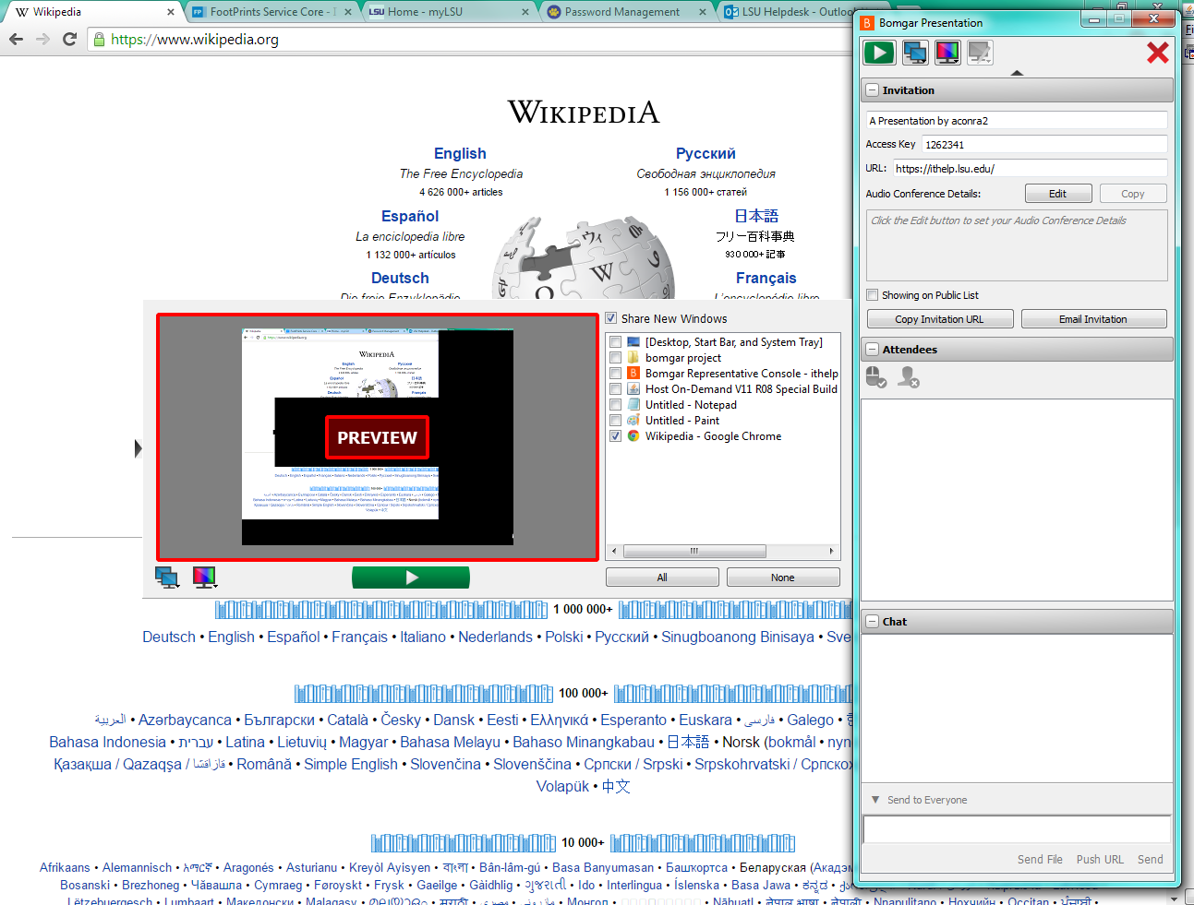

Slide 31
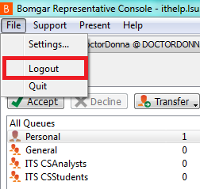
Finishing up
Once you are done with your troubleshooting, you can end a particular support session without closing the program
But don’t for get to log out! When you are done with Bomgar for the day!

